Slide 1
Using Schemas
server.database.dbo.table

Slide 2
Schemas
What are schemas?
The structure of your database (think schema = level 1, table = level 2).
Why use schemas?
It is way to organize a large set of tables into smaller collections within the same DB.
It also allows you to set permissions when you have multiple users.
Advance Design:
Remember dbo? That is the “default” schema. Here we will apply multiple schemas.
Last time, you learned how to create your own database on your laptop as a file. Here you will learn how to create a remote server database with multiple users. Those users will be granted permissions based on access level needed (schema).

Slide 3
Schema: 4 part format
Syntax:
Server.Database.DatabaseSchema.DatabaseObject (DBO)
Server.Database.Schema.Table
Documentation: https://docs.microsoft.com/en-us/dotnet/framework/data/adonet/sql/ownership-and-user-schema-separation-in-sql-server

Slide 4
Getting into the habit of 4 part mapping
USE database1
CREATE TABLE schema1.table1 (pkcol1 int, col2 varchar(20))
SELECT * FROM database.schema.table.column

Slide 5
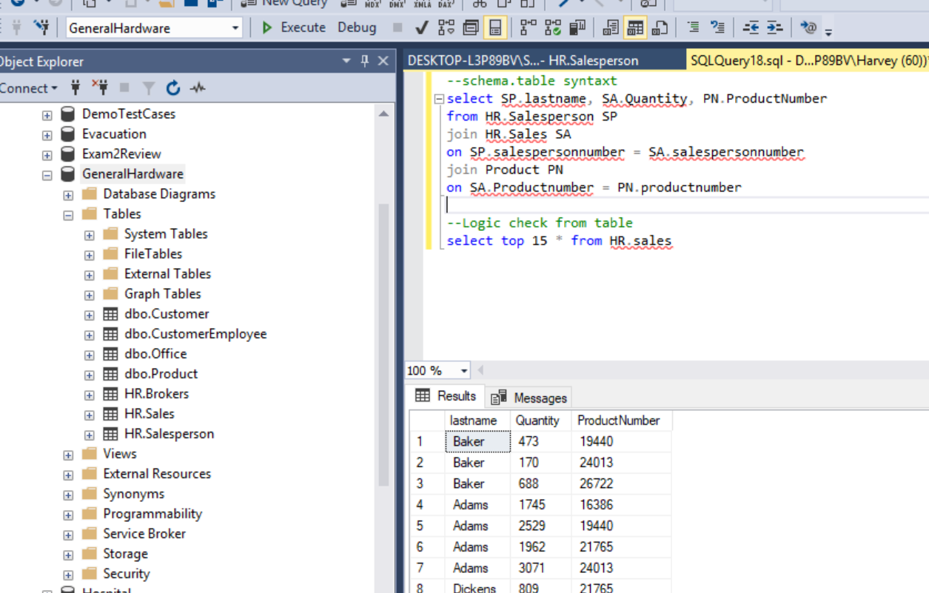
Default schema is “dbo”
This is also help when creating system generated (reverse engineered) ERDs.
You can have an ERD for each schema.

Slide 6
Practice Code
--schema.table syntaxt
select SP.lastname, SA.Quantity, PN.ProductNumber
from HR.Salesperson SP
join HR.Sales SA
on SP.salespersonnumber = SA.salespersonnumber
join Product PN
on SA.Productnumber = PN.productnumber
--Logic check from table
select top 15 * from HR.sales

Slide 7
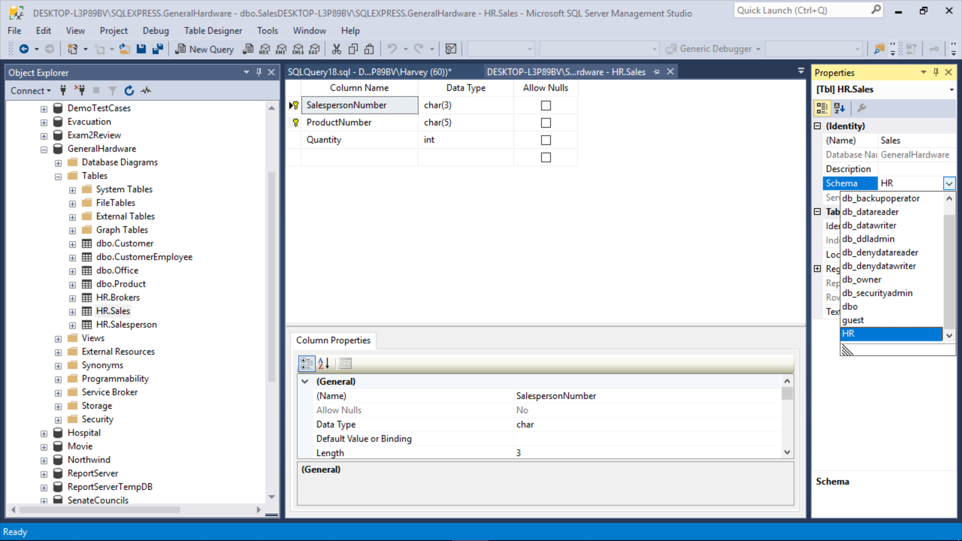
Using F4 in Table Design to Access Properties

Slide 8
AdventureWorks Example

Slide 9
Schema Exercise
Create a database with at least 3 schemas.
You may create a new database or revise a previous design.

